Slide 1
Better Testing Through Process Automation
PNSQC 2018
Portland, Oregon
By Rick Tracy
@KITesting

Slide 2
Oh Dear God Why?
The Request
@KITesting
9 Teams
One Global Financial System
One Continuous Regression Test
At least every two weeks with full feedback and continuous, untested code deployment and collaborative team review and bug fixes
Notes:
A request comes in to the department, and everyone scrambles to not be involved with working on it

Slide 3
Oh Dear God Why?
@KITesting
No Designated Team
No Timelines
No Criteria
Automated
Notes:
There are severe problems in the request, and while that means we have no basis, it also gives opportunities to design things from scratch

Slide 4
Better Testing Through Process Automation
PNSQC 2018
Portland, Oregon
By Rick Tracy
@KITesting
Notes:
Welcome to the world of Process Automation

Slide 5
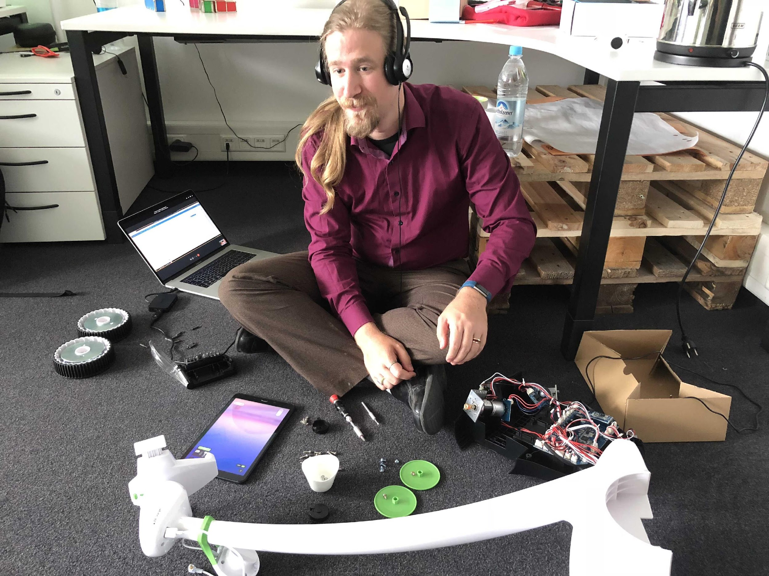
Who Is This Guy?
@KITesting
Notes:
I‘ve been at this for a while, testing, connecting, designing and building, and researching AI and robotics to collaborate in IT

Slide 6
Limits Of Value In Automation
@KITesting
“Automation Isn‘t Everything“
Peter Hartauer
Notes:
We can‘t rely on automation being valuable simply because it is automated

Slide 7
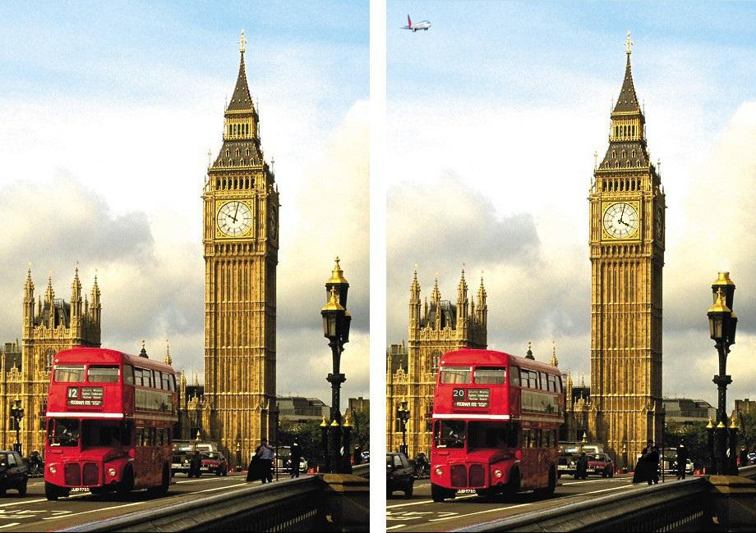
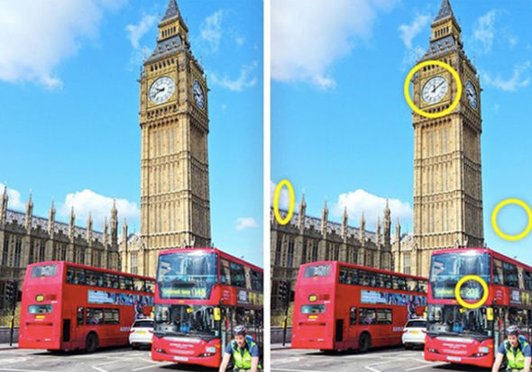
So What‘s The Idea?
@KITesting
Automated Validation Process
All the known or expected items automated in rules
If marked as OK, not even indicated anymore by Automated Check
Leaves all the novel and unique issues for manual analysis
Notes:
We see priorities, even as children, because we do basic pattern recognition. Automated validation imitates that, but instead looks at everything and returns all data. It‘s up to us to look for unique values.

Slide 8
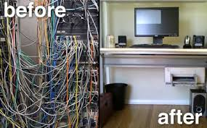
So What‘s The Idea?
@KITesting
Searching for the right approach
Key command log
Cloud based automation
Background functionality scripts
Notes:
We can use imitation tech, shared tech, or just build a lot and hide it behind software interfaces

Slide 9
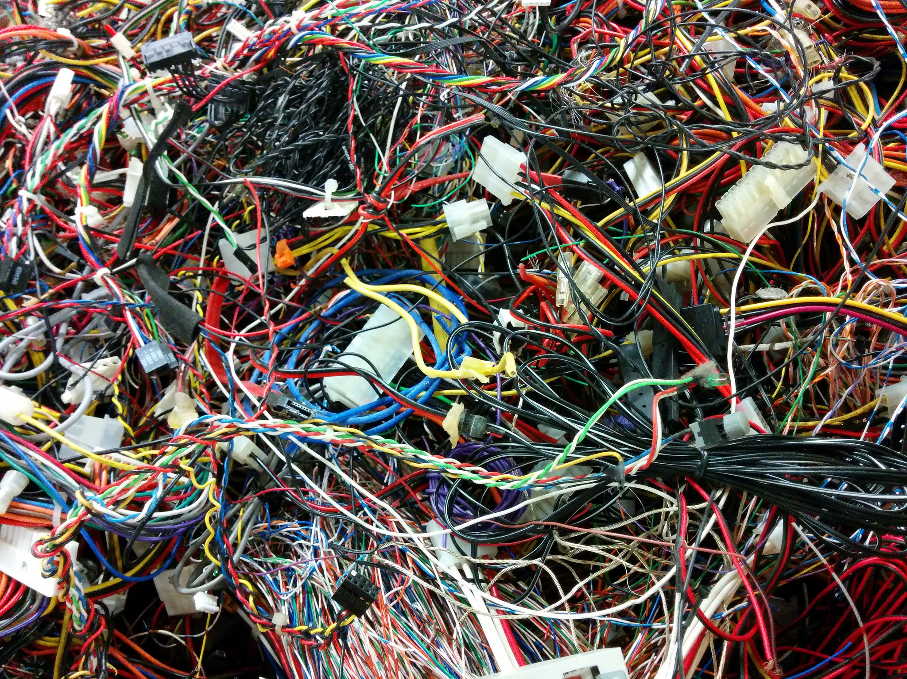
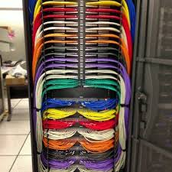
Clean Processes
@KITesting
Notes:
You will spend far too much time and money automating a messy process. Step one: CLEAN UP!

Slide 10
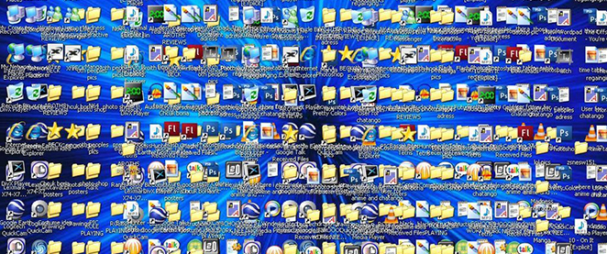
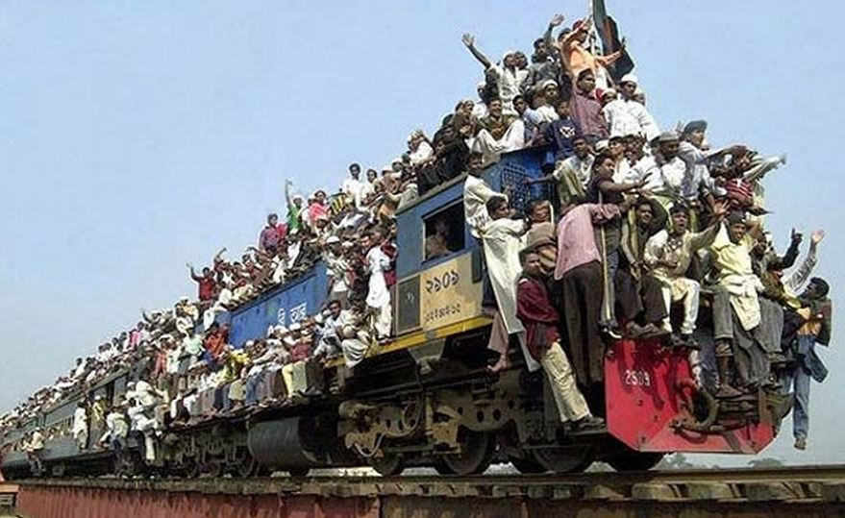
Impediments
@KITesting
Heavy GUI testing
Process intermingled with user actions
Notes:
Any alteration in GUI means a lot of work.
Users will also use items in many often problematic ways

Slide 11
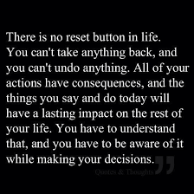
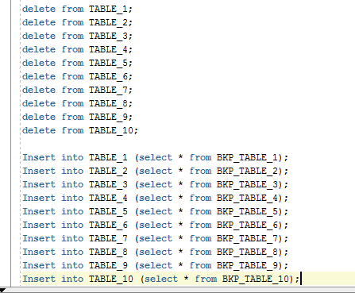
What Did We Try?
@KITesting
Notes:
Time to throw out the rules; yes, we can reset, quite easily actually!

Slide 12
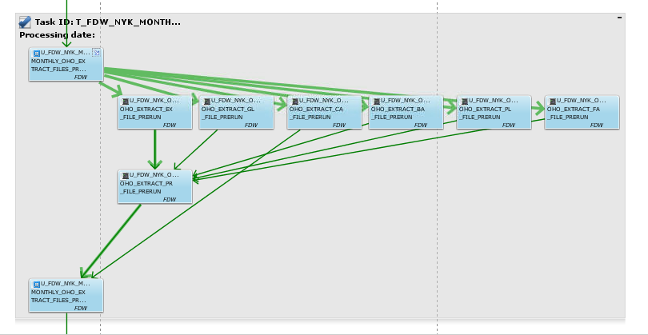
What Did We Try?
@KITesting
Batch/Report Generation Automation:
Took Batch commands and added them to validations
Combined the reset and the validations with the process
Used Validation rules to decide if it went on or not
Notes:
Making a test process that mimics the developed product is double the work, but effective for testing it all. But it is now a mimic, not the actual product!

Slide 13
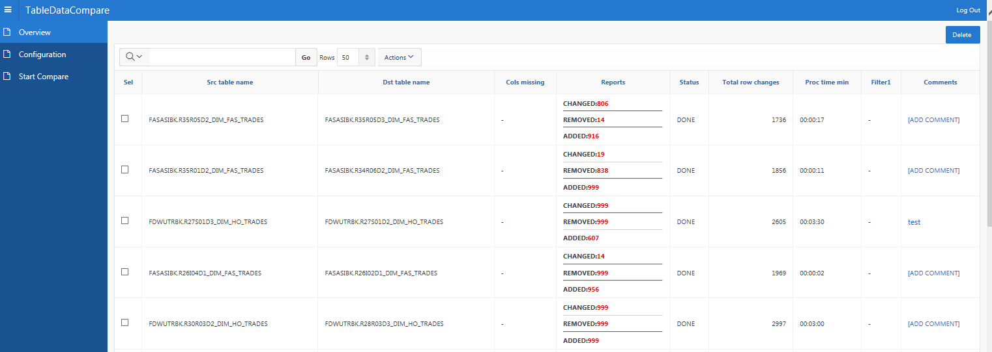
What Did We Try?
@KITesting
Creation of Full Automatic run and validation suite
Limitations on amount due to scope of automation
Heavy Maintenance
Lots of results to analyze
Notes:
Full analysis of all data tables is possible, but so much data, unanalyzed, is worthless.

Slide 14
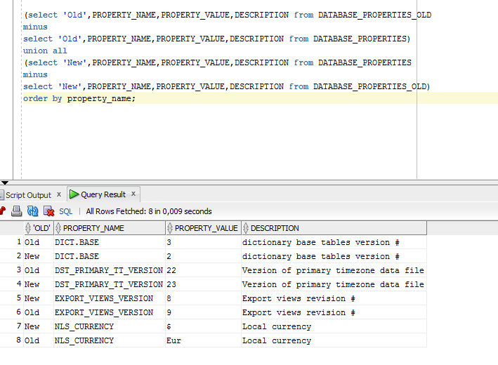
What Did We Try?
@KITesting
Reverse Engineered Test Scripts
Took the principles in the tool and used them to create my own validations
Saved me the time to isolate them all and let me analyze
Notes:
Spot tests are possible once those in depth data coparisons are done. However even this is limited to what you design as an important check

Slide 15
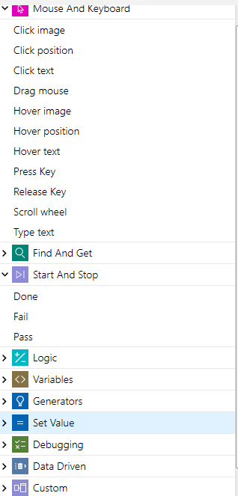
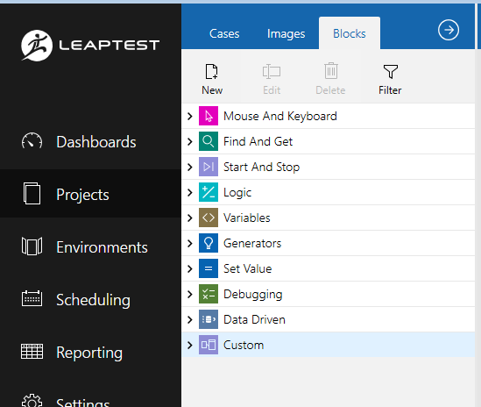
Abusing Software
@KITesting
Automation Tool
GUI reliant, but flexible
Block-like automation
Maximum Customization
Notes:
Take a commercial tool and use it to automate a process, rather than use the actual pre-made tests from it

Slide 16
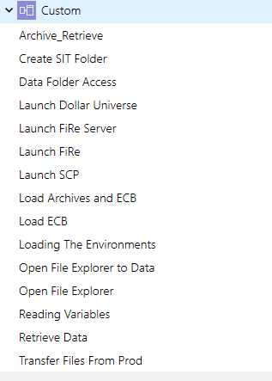
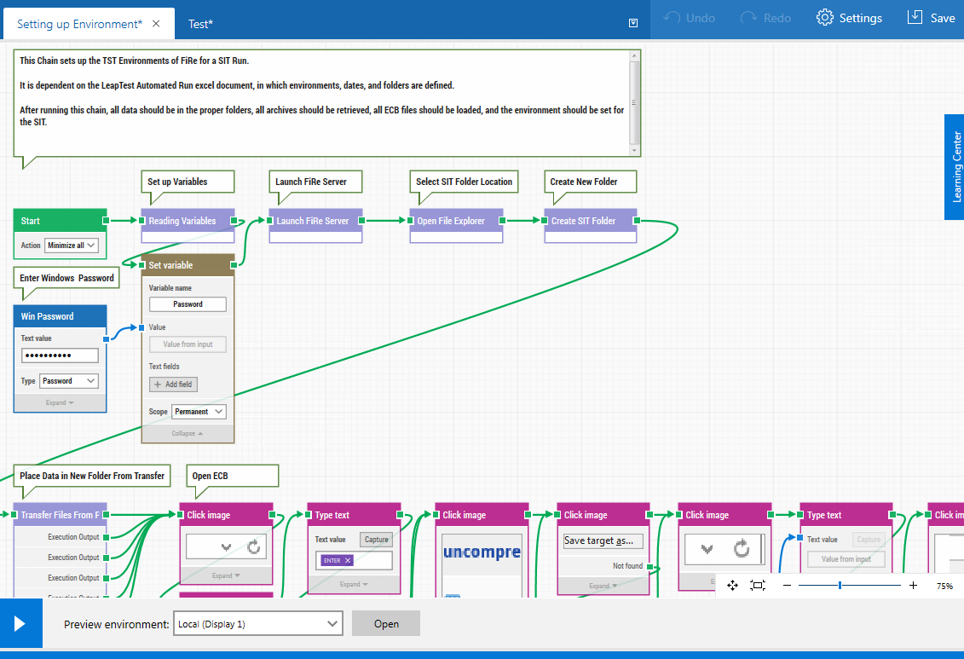
Abusing Software
@KITesting
Making it your own
Automated annoying manual processes
Small functions
Little blocks
Redesigned the purpose of the test suite to automate process
Notes:
Custom design is possible with these tools, even if you have little to no knowledge of how to code.

Slide 17
Automated Testing Versus Process Automation
@KITesting
Automation
Process
Versus Test Automation
Notes:
We need to point out that the goal is not to have automated testing, but to give the most information in the most reliable and effecient manner possible. If we can automate how we RUN the tests, then we have lots of extra time to EXAMINE the results of the test.

Slide 18
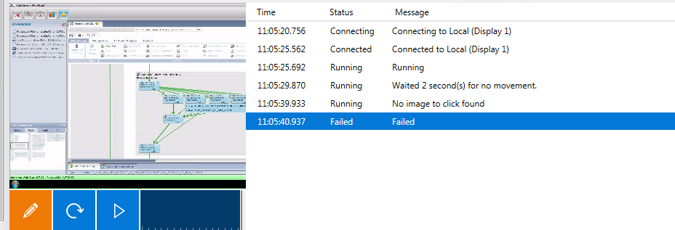
Lessons Learned
@KITesting
GUI Failure needs backup and Log

Slide 19
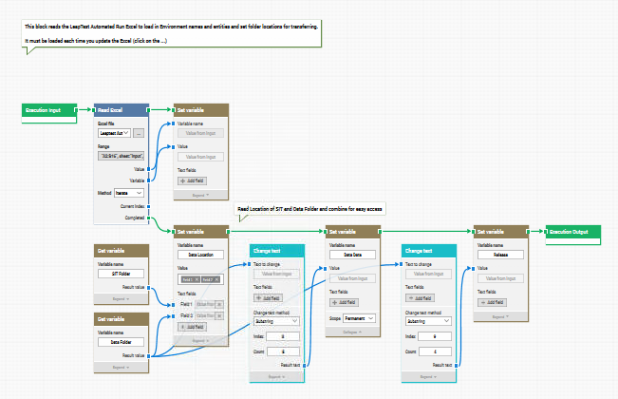
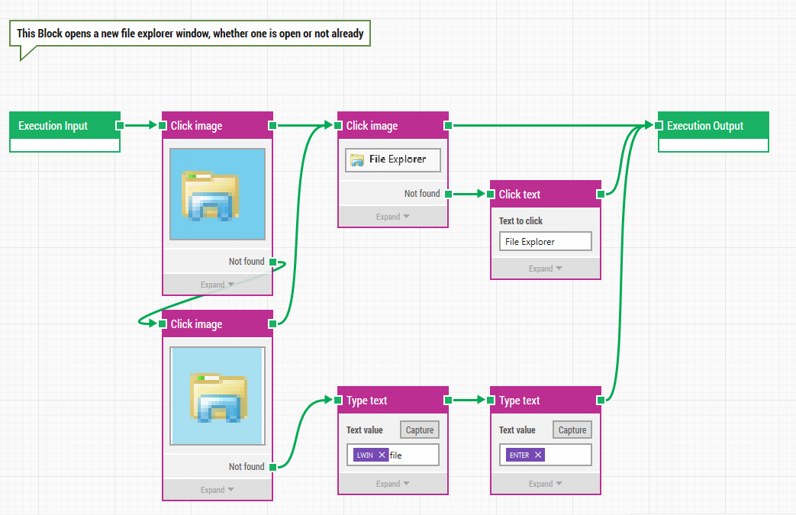
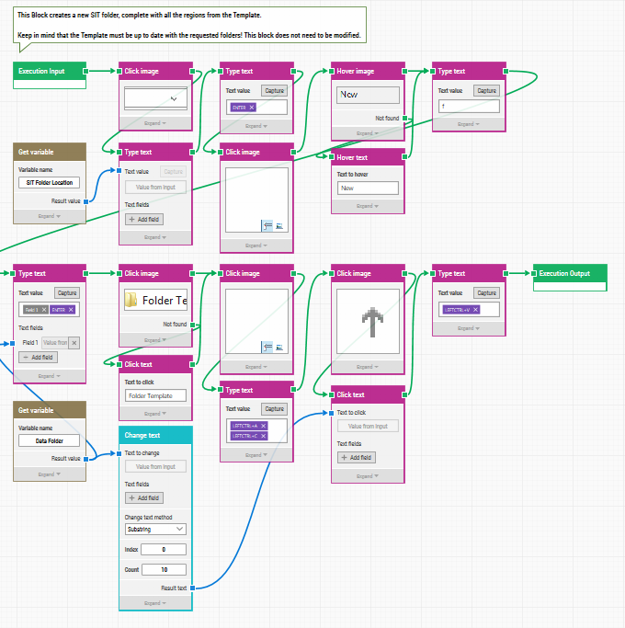
Lessons Learned
@KITesting
Functionality In Blocks Is Easier To Manage

Slide 20
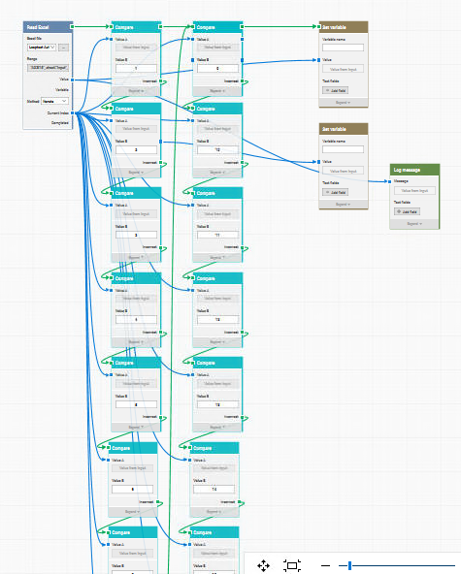
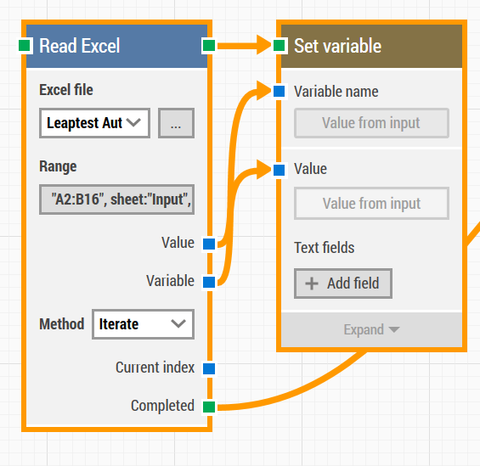
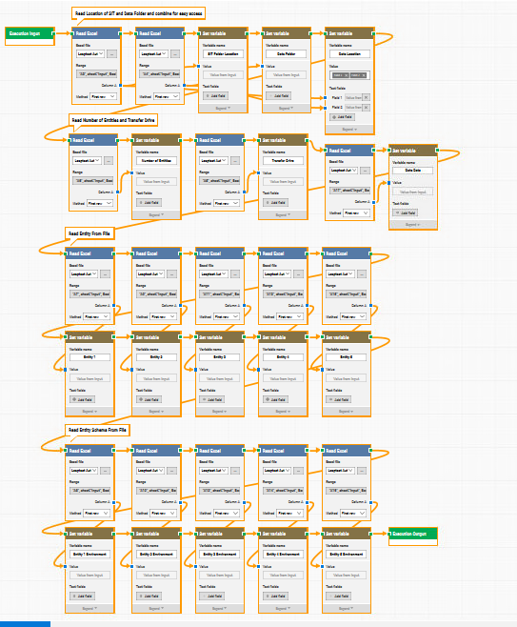
Lessons Learned
@KITesting
Approach global, not individual
What can be combined?

Slide 21
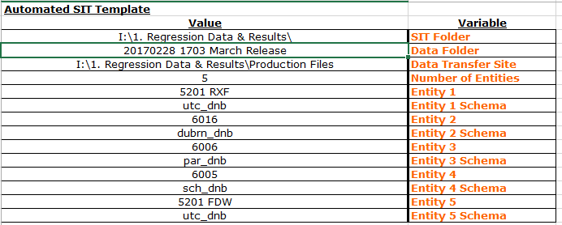
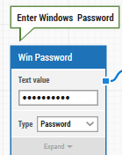
Lessons Learned
@KITesting
Single Point of Maintenance, Easily Defined

Slide 22
Overall Lessons Learned
@KITesting
Focus on what you want to produce
Look at how you do it now (and improve!)
Think about your approach
EXPERIMENT!
Automate the process for easy recycling of tests and to help others save time (ex: UAT)

Slide 23
Thank you! Questions?

